Slide 1
4. Profit and Value
Topic 1. What is a Business?
Chapter 1. Business Basics.
Unit 1. The Context of Business.
MXA101 – Introduction To Business
-By ManageX Academy

Slide 2
Why Profit and Value Matter
Basis of business decisions
Drives investor confidence
Impacts growth and sustainability
Foundation of strategy

Slide 3
What is Profit?
Profit = Revenue – Expenses
Measures short-term performance
Shows operational success
Essential for survival

Slide 4
Types of Profit (Business View)
Gross Profit
Operating Profit (EBIT)
Profit Before Tax
Net Profit After Tax

Slide 5
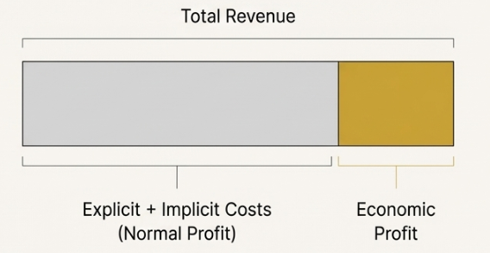
Normal Profit vs Economic Profit
Normal profit = opportunity cost
Economic profit = real surplus
Includes implicit costs
Used for strategic decisions

Slide 6
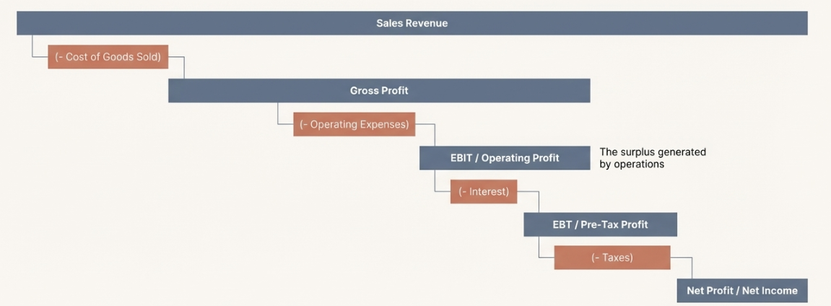
Profit Maximization Concept
Goal: maximize difference between revenue and cost
Not just maximum sales
Optimal operating point
Strategic pricing & output

Slide 7
Real-World Profit Maximization Example
Pricing decisions
Cost control
Demand sensitivity
Competitive positioning

Slide 8
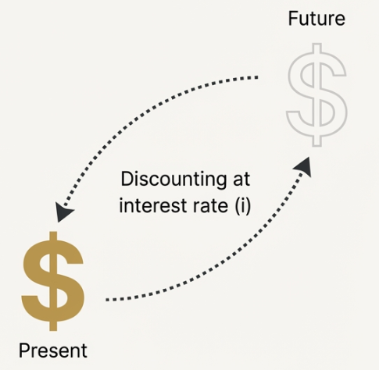
Introduction to Value
Value ≠ current profit
Long-term perspective
Based on future earnings
Investor viewpoint

Slide 9
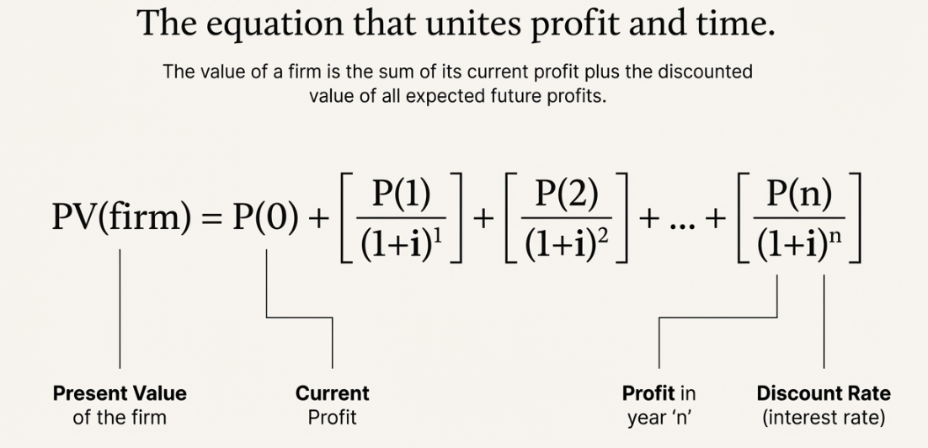
What is Business Value?
Present value of future profits
Time value of money applied
Risk-adjusted expectations
Core of valuation

Slide 10
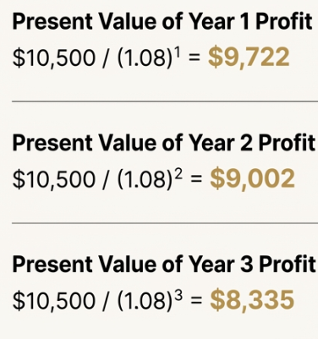
Why Present Value is Important
Money today > money tomorrow
Inflation impact
Risk consideration
Investment decisions

Slide 11
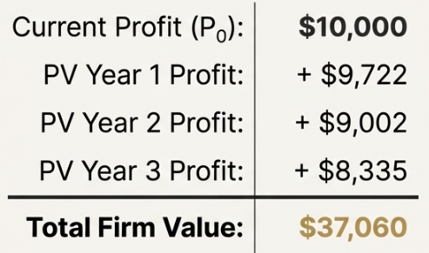
Profit vs Value – Key Difference
Profit = short-term
Value = long-term
Operational vs strategic
Manager vs investor focus

Slide 12
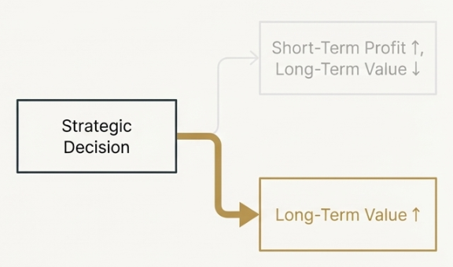
Link Between Profit Maximization & Value
Profit drives future cash flows
Sustainable profit increases value
Short-term profit traps exist
Long-term thinking required

Slide 13
Strategic Decisions Impacting Value
Investment in innovation
Brand building
Customer loyalty
Risk management

Slide 14
Role of Strategy & Competition
Competitive advantage
Industry structure
Strategic interactions
Long-term positioning

Slide 15
Key Takeaways
Profit shows performance
Value shows potential
Both are interconnected
Strategy bridges the gap

Slide 16
Conclusion
Profit builds survival
Value builds legacy
Learn to think long-term

Slide 17


